Slide 1

MoneyBall
Moaz175888 , Mostafa173112

Slide 2
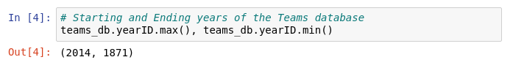
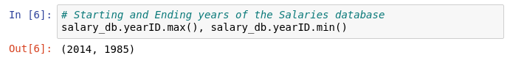
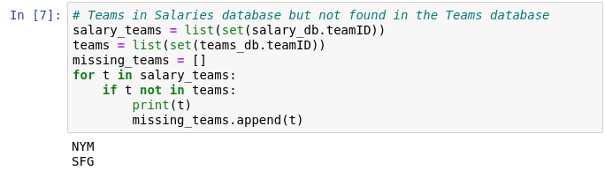
Data Wrangling - First Look
1. Time Periods
2. Teams with two teamIDs in different databases

Slide 3
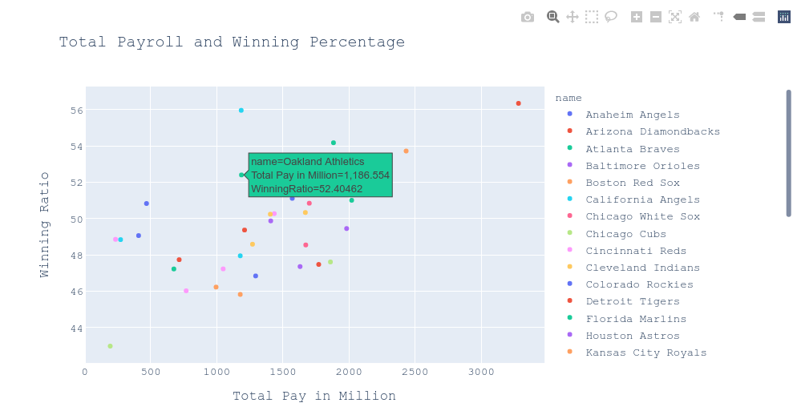
Data Wrangling - Data
Query - Dealing with missing data using SQL
Inner-Join
Years Range
Total Pay & Winning Ratio

Slide 4
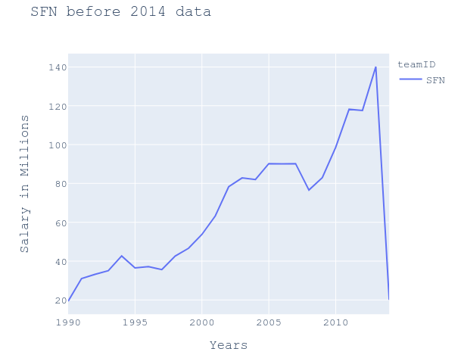
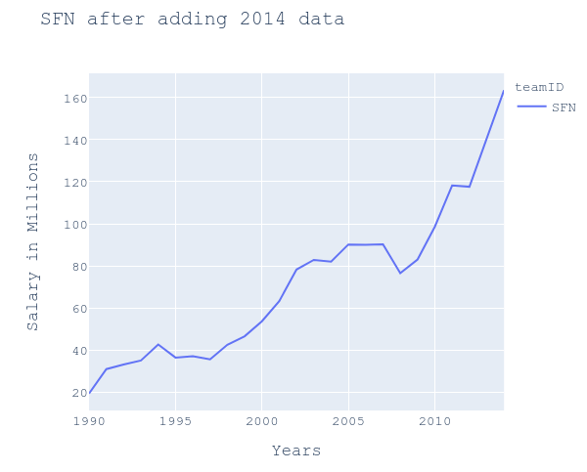
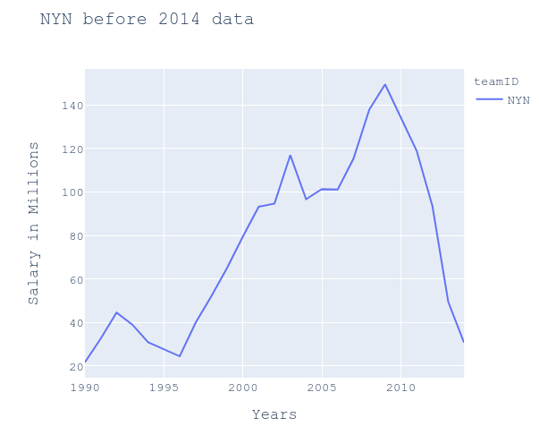
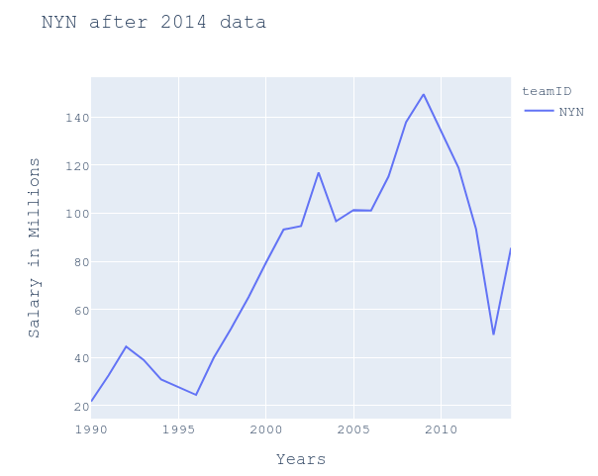
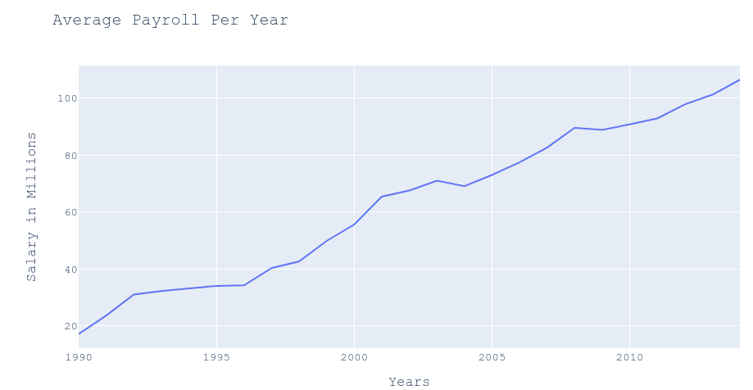
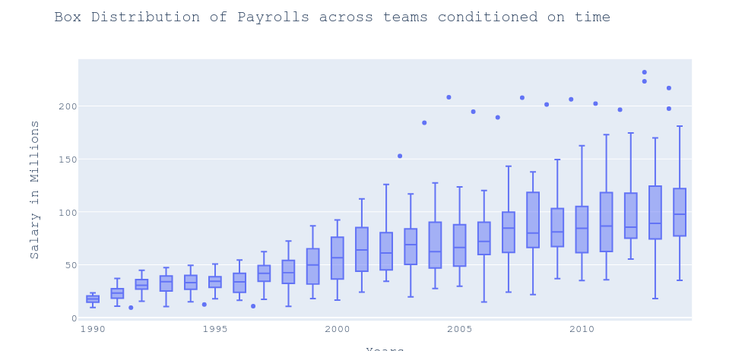
Exploratory Data Analysis
2. Dealing with Teams have two IDs
Payroll Distribution

Slide 5
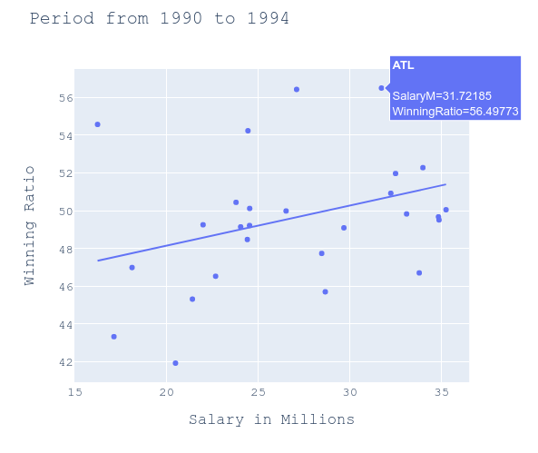
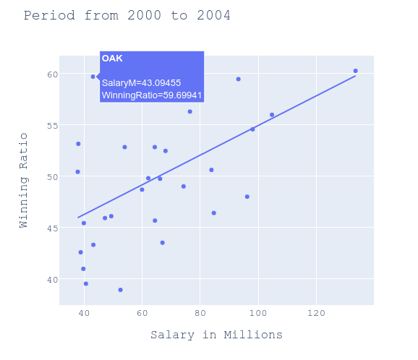
Exploratory Data Analysis - Correlation
Notes:
Are there any teams that stand out as being particularly good at paying for wins across these periods?
ATL had the highest winning ratio although it wasn't the highest paying team for nearly all the time periods always about %50 winning ratio and sometimes reaching 60%
What can you say about the Oakland A's spending efficiency across these periods?
At the first time period, OAK was one the most paying teams and has a high winning ratio higher than 50%
At the moneyball period, OAK has the thier highest winning ratio of 59.6% which landed it the second place at the league at NYA which has a winning ratio 60.2% but payed 133 Millions where OAK payed 43 Millions
After that OAK didn't pay much and kept their winning ratio above 50% compared to the rest of the teams

Slide 6
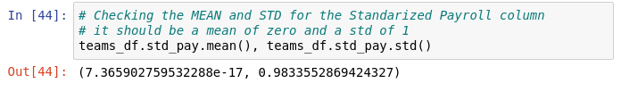
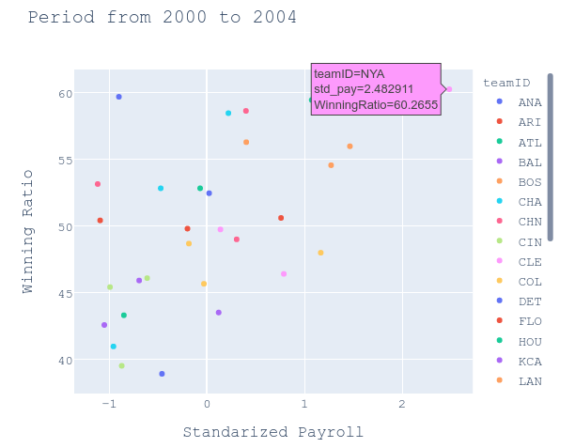
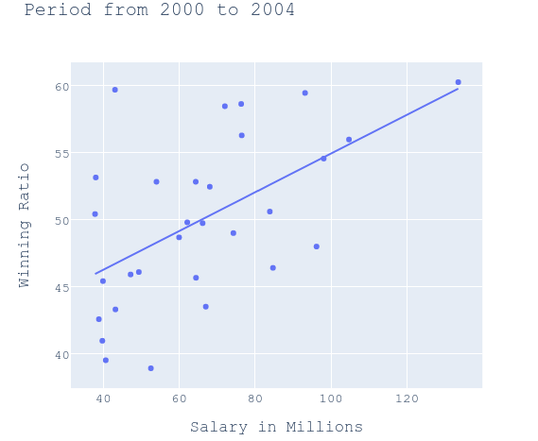
Data Transformations - Standardization
Standardization
Notes:
The relationship with respect to the graph before the data transformation
Standarizing the data shows which points are near the mean point.
We found that the plots were almost the same with no noticed difference after changing the unit of the X-axis.

Slide 7
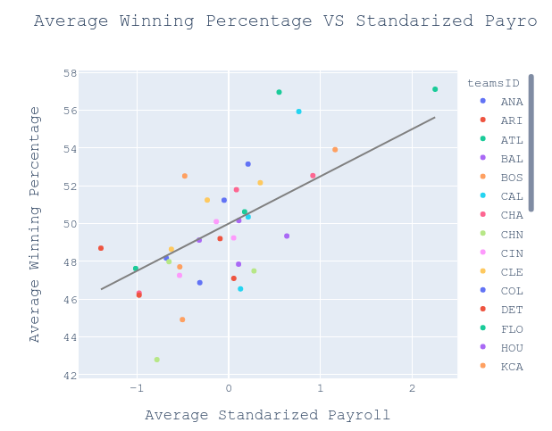
Data Transformations - Expected Wins
Notes:
There are a few teams that are near their expected winning percentage or higher than it most of the time like NYA and OAK
and There's ATL and LAA which is above their expected winning percentage nearly all the time.
and the rest of teams are keeping a balance between being above the expected win or lower than it

Slide 8
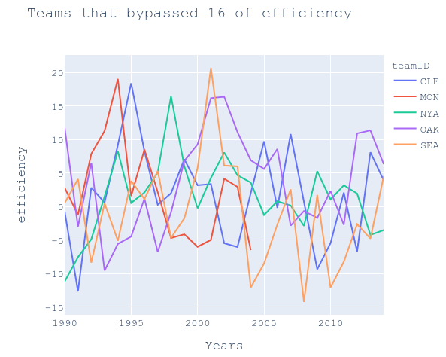
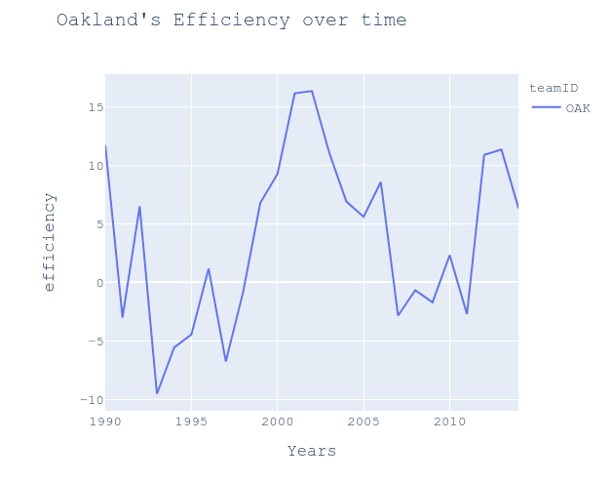
Data Transformations - Spending Efficiency
Notes:
OAK efficiency was at its highest at the moneyball periods
It made it clear that their strategy worked really well

Slide 9
Conclusion

